Slide 1
Cyber Security Breaches
By
John Haag, Nick Staub, Sean Edwards, Kingsley Okereke, Zach Kovalenko

Slide 2
Abstract
In this project we will discuss a detailed analysis of Cyber Security breaches in the USA from 2009 to 2014.
The conclusions we have drawn from the analysis of this data set have been from using various techniques writing code in R and Rstudio.
These conclusions in real world scenarios with the correct data set could lead to important business decisions that may help lead to significant updates in a companies security of software, systems, and decrease in loss of money and information due to cybersecurity breaches.

Slide 3
Introduction
During our research we used the USA cybersecurity breaches data-set to draw useful information for any entity interested in updating security measures to better prepare for the future.
With a Team of 5 we were able to define pertinent questions that by answering would help us produce useful information about our subject matter.
The problem that we are trying to solve Is how to effectively address future cybersecurity breaches and avoid them with the observations made from the data.
This problem was chosen because of previous classes of some team members as well as an interest in cybersecurity for other members.

Slide 4
Introduction continued
As a team of 5 members each member was tasked with developing a question that would lead to our end goal of defining the truths from the data to avoid future breaches.
Along with developing a question each member was also tasked with providing an answer to that question.
On top of answering these questions our team has also provided multiple predictive models that will predict the number of breaches per year after our data set no longer has information available.
Our data set contains the following details, number of breaches, Year, date breached, individuals affected, summary of breach, name of entity breached, the state where the breach took place, type of breach, and location of breached information.

Slide 5
Initial Goals
See correlation of security breaches over time
See the correlation between type of breach and number of individuals effected by the breach
See the correlation between the number of breaches and location by state
We also wanted to see which type of breach is most common
All this information so companies can make better decisions about what kinds of security to invest more resources

Slide 6
Dataset
Various information regarding data breaches in the US
https://public.tableau.com/profile/chris1505#!/vizhome/DatasetExplorationandDowbload/DatabaseDash?publish=yes.
Tableau is one of the leaders in data science holding of information, many data scientist use this website for sharing and collaboration with other data scientists.

Slide 7
Data analysis and Modeling
Visualization methods:
Spline Chart
Multiple Bar Graphs
Deeper Understanding:
Confusion Matrix
SVM
Machine Learning Techniques:
Linear Regression Model
Multiple Regression Model
Generalized Linear Model
How did we reach our conclusions?
Using various visualization methods and data analysis skills.
Machine Learning which helped us make educated predictions about the future.

Slide 8
Cleaning the Dataset
Removed irrelevant columns with NA values
Corrected the names of companies
Changed dates to date datatype instead of character string data type
Easier to use date data and sort by time

Slide 9
Is there a relationship between number of breaches and breach year? is it statistically significant?
To answer this question I first created a linear model using the lm() function in R. Once I created the object I used the summary() function to get the P value and other important information. Here are some of the results.
p-value: < 2.2e-16, Adjusted R-squared: 0.5426
Coefficients:
Estimate Std. Error t value Pr(>|t|)
(Intercept) 2.009e+03 6.582e-02 30527.19 <2e-16 ***
Number 3.826e-03 1.081e-04 35.37 <2e-16 ***

Slide 10
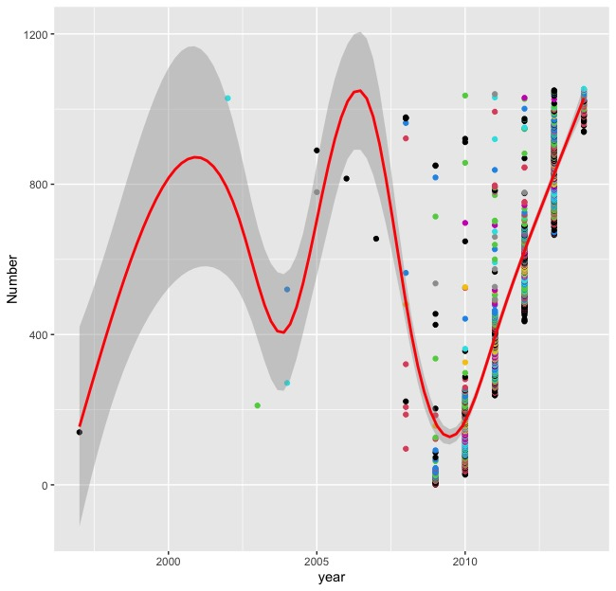

Slide 11
Conclusion of question
The results, this graph and summary of linear model show that as the years increase the number of total breaches will also increase.
With the Adjusted R-squared value = 0.5426 this shows only slightly better than 50% of the goodness of fit. showing this model could be better and that 46% of the points on this graph are a variation of the linear model.
With the P-Value = < 2.2e-16, this shows that we will reject the null hypothesis, which is that as the years go on the number of breaches will be zero. This shows this linear model is statistically significant.
In conclusion this model will show a statistically significant model and predict the future breaches by year with 54% goodness of fit.

Slide 12
Which states have the largest number of individual breaches and what type of data breach was most dominant?
Throughout 2009-2015 there were many large data breaches that occurred but some more significant than other so when I came across this question I ask myself how could make these number more easy to follow so I narrowed down the data set to the top 25 states.
I thought by doing this it would give a clear picture of which breaches where the largest and most dominant. I came to the conclusion of Illinois having around 4 million individuals affected and Virginia had the largest amount from one attack at 4.9 million individuals.
Some states such as California and Florida had multiple events affecting individuals and not just one California having 5 events them totaling to around 3.7 million and Florida totaling around 2.2 million individuals.
I used visualizations such as a bar chart and confusion matrix to better comprehend how these are seen.

Slide 13

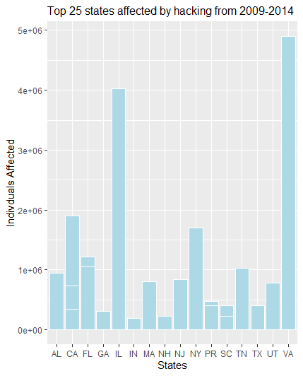



Bar Chart

Slide 14
Confusion Matrix and SVM
So when reading the matrix that we created it shows the states in the top 25 and compares them to the rest of the spectrum of the data and where it falls.
I have also used a generalized linear model to show the different results with the data such as the null and residual deviance having low values of 8.3972 and 8.3967 which means strong goodness of fit if and when the data is placed in the model like the bar chart.
Another key piece is the high statistical significance of 9.290e-07 which show the data being very relevant and essential in interpreting the rest of the data set.

Slide 15
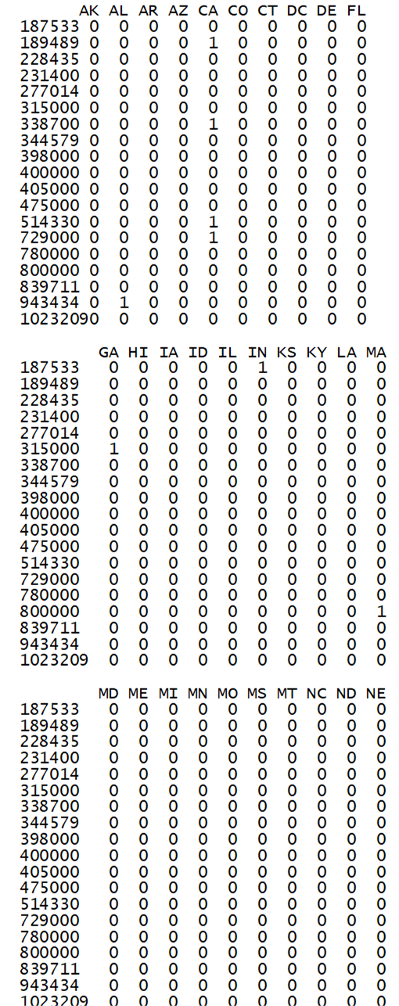
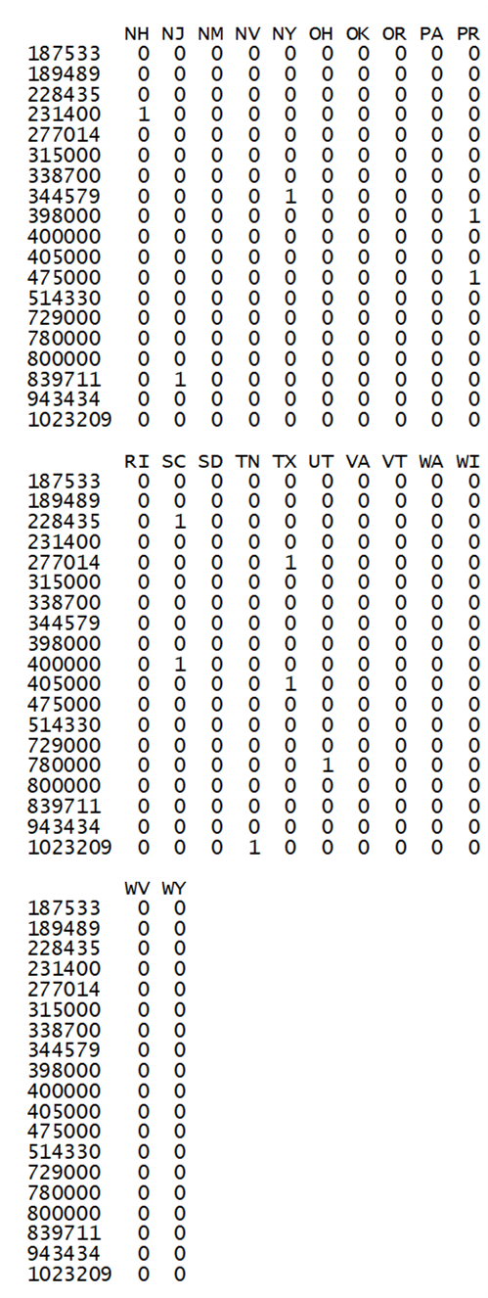
Confusion matrix Diagram and SVM Stats

Slide 16
Are certain devices more susceptible to data breaches according to the data given?
To determine which devices were more susceptible to data breaches first we had to clean up the data to remove the parts of the data that had multiple points of breach.
To best demonstrate visually which device was most likely to be breached we used a bar chart. Which showed, the Number of Breaches per Data Storage Device that was breached.
Based on our findings data stored on a piece of paper was most likely to be breached. But, a Laptop was a very close second as can be seen in the bar chart that follows.

Slide 17
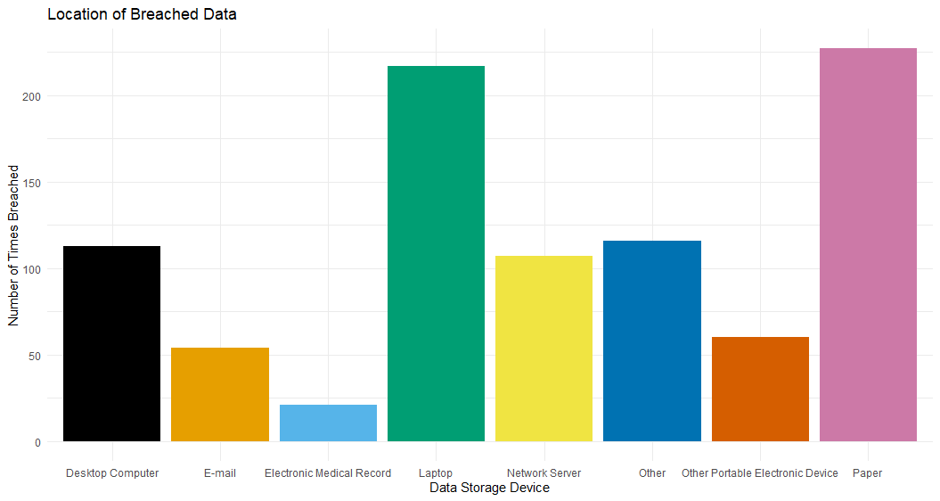
Bar chart: Location of Breached Data

Slide 18
Is there a relation between the type of breach and the number of individuals affected?
To answer this question the first step was to create a bar graph displaying to visualize the data
To do this and maintain readability a limit had to be selected for what categories of data would be shown.
The limit was set on the number of individuals affected
The less significant data was excluded from the graph to maintain visibility
After the graph was created it was simple to make conclusions from the visualized data.

Slide 19
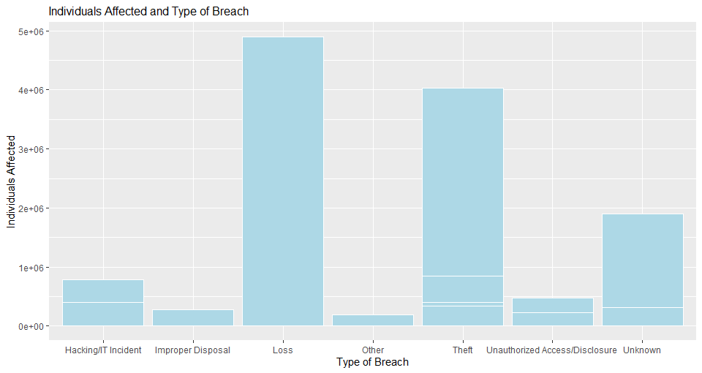

Slide 20
Is there a relation between the type of breach and the number of individuals affected?
Out of the known types of breaches thefts and loses had a significantly higher impact on individuals in comparison to all of the other known types of breaches
This data is useful; this could help individuals and group better protect their confidential data from unexpected loss
It can give an idea what the biggest threats are regarding cybersecurity

Slide 21
Is there a relationship between individuals affected and total number of breaches?
One way I tried to answer this question was to use a correlation test. The results of the correlation test are shown below.
data: Individuals_Affected and Number
t = -0.72759, df = 1053, p-value = 0.467
alternative hypothesis: true correlation is not equal to 0
95 percent confidence interval:
-0.08265914 0.03799009
sample estimates:
cor
-0.02241614

Slide 22
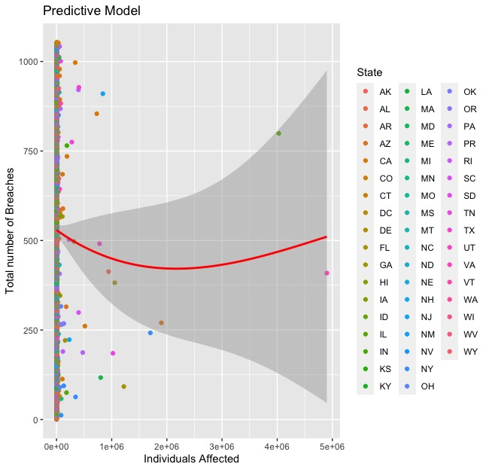

Slide 23
continued
This correlation test shows a P-value of 0.467, this shows a weak uphill relationship for individuals affected and number of breaches but close to moderate relationship.
This test also shows the COR to be -0.02241614 which means that we reject the null hypothesis. Which means true correlation is not equal to zero this is shown with a 95% confidence interval. These results show a correlation in our data and I have made a visualization model to better understand these findings.
Using ggplot I have plotted the Individuals affected with Number of breaches to show the slight uphill relationship. With a geom_smooth line this shows the potential in the future for increase in individuals affected regardless of the number of breaches changing.

Slide 24
Future handling of data
Just like many datasets new information for cybersecurity breaches will be available in the coming years
In order to better understand future modeling if only a few new pieces of data were added to our data set we would use a Support Vector machine to determine where this data belongs within our dataset
Having a threshold and which ever side that piece of data fell would determine where that data was put on a graph and how it is categorized.

Slide 25
Final Outcomes and Analysis
Main Result: The Number of Breaches has gone up as the years have progressed. This trend will continue. This is due to the rise in advanced technology and its increasing use by everyday people.
Machine Learning Prediction: The different types of breaches will continue to rise as technology and the years progress.
Initial question answers:
A relationship between the number of breaches and year has been found.
Thefts and Losses had a larger impact on individuals than all of the other types of breaches compared.
Paper was the most susceptible to a data breach. But, Laptops were a very close second.
Virginia had the most people that were affected by Data Breaches.
Predictive models showed the number of data breaches will rise as time progresses.
Justified answers: Using various visualization methods and predictive Machine learning models.

